Slide 1


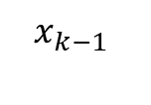
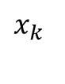
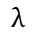
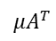
Architectural priors
$$λ$$
$$x_{k}$$
$${μA}^{T}$$
+
$$I−μA^{T}A$$
$$x_{k−1}$$
(Group) convolutional neural networks
Recurrent neural networks
Deep unfolding

Slide 2
Convolutional networks
feature map
Locally connected + shared weights
kernel
etc
etc
Input
Fully connected
1D convolutional
(kernel 3)
independent
weights

Slide 3
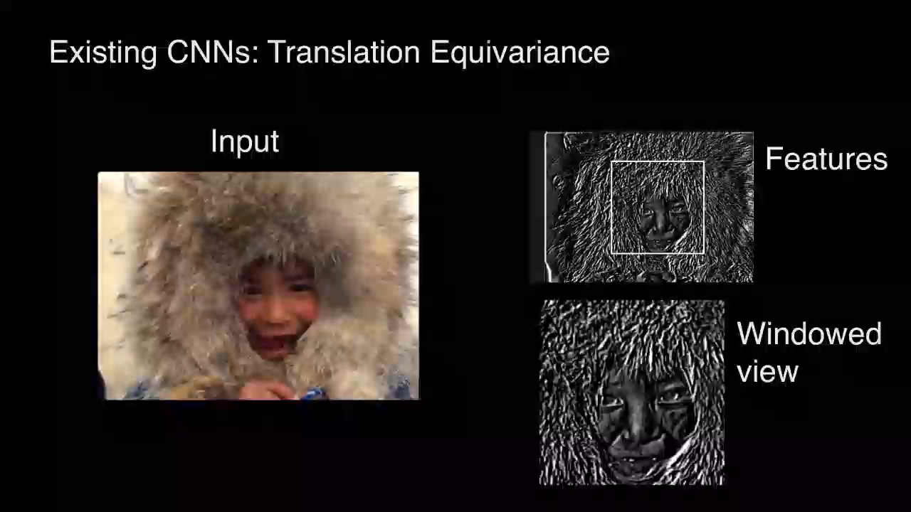
Convolutional networks
Strong prior: translational invariance
feature map
kernel
Input
(Cohen, 2016)

Slide 4
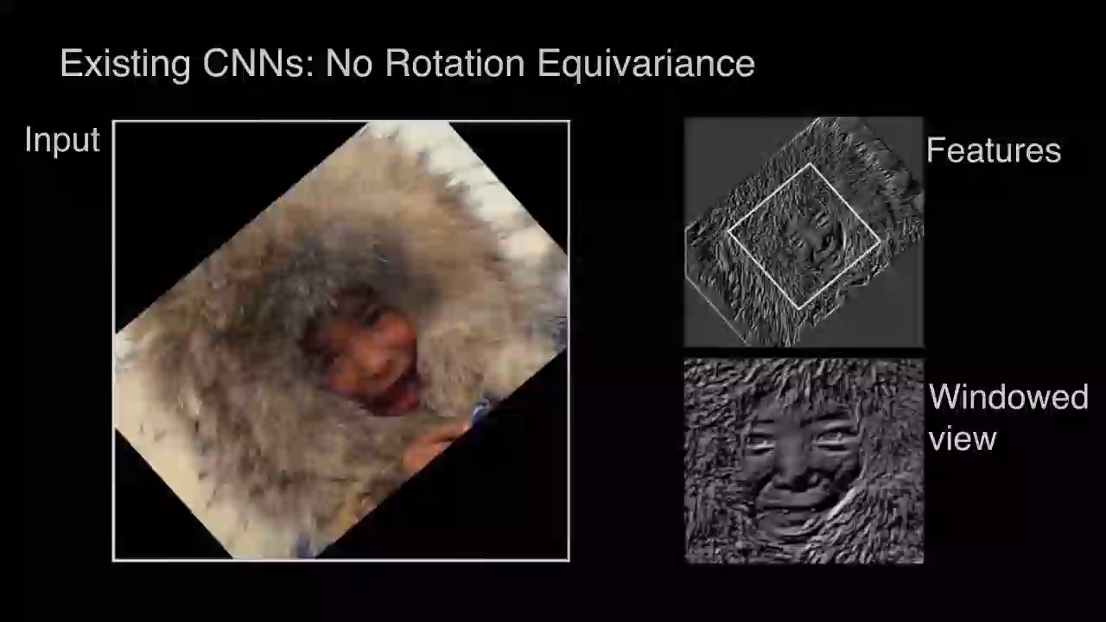
Convolutional networks
Not invariant to rotation! …data augmentation/spherical harmonics
feature map
kernel
Input
(Cohen, 2016)

Slide 5
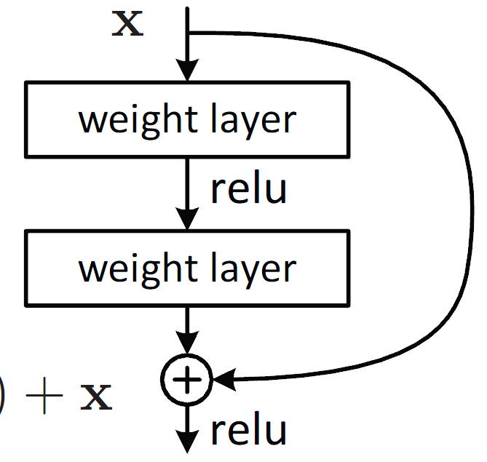

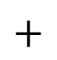
Residual networks
Weight layer
Residual connections
Weight layer
$+$
Much more efficient training with faster convergence

Slide 6
Residual networks
ResNet-56
ResNet-56
Without residual connections
With residual connections
Word of caution: loss surface under
strong dimensionality reduction
Priors matter! Some neural architectures are easier to minimize than others
Source: Goldstein et al., NeurIPS 2018

Slide 7
Architectural priors
$$λ$$
$$x_{k}$$
$${μA}^{T}$$
+
$$I−μA^{T}A$$
$$x_{k−1}$$
(Group) convolutional neural networks
Recurrent neural networks
Deep unfolding

Slide 8
Recurrent networks
An unrolled recurrent neural network
http://colah.github.io/posts/2015-08-Understanding-LSTMs/

Slide 9

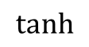
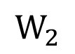
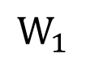
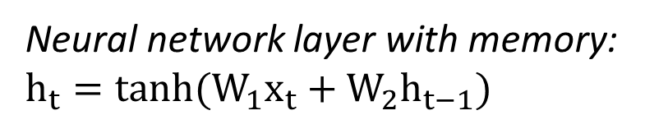
Recurrent networks
$$tanh$$
State
$$W_{2}$$
Memory
Long sequences: vanishing gradients…
(no long-term memory)
$$W_{1}$$
New input
Neural network layer with memory: $h_{t}=tanh{(W_{1}x_{t}+W_{2}h_{t−1})}$
http://colah.github.io/posts/2015-08-Understanding-LSTMs/

Slide 10

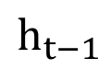
Recurrent networks
LSTM: Long short term memory networks
cell state
$h_{t−1}$
http://colah.github.io/posts/2015-08-Understanding-LSTMs/

Slide 11
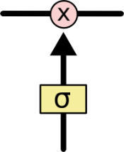
Recurrent networks
LSTM: Long short term memory networks
cell state
Gates
Control & ‘protect’
cell state
http://colah.github.io/posts/2015-08-Understanding-LSTMs/

Slide 12
Recurrent networks
LSTM: Long short term memory networks
cell state
Which cell state information is preserved?
http://colah.github.io/posts/2015-08-Understanding-LSTMs/

Slide 13
Recurrent networks
LSTM: Long short term memory networks
cell state
What new information
is added?
http://colah.github.io/posts/2015-08-Understanding-LSTMs/

Slide 14
Recurrent networks
LSTM: Long short term memory networks
cell state
Output: processed version of current cell state
http://colah.github.io/posts/2015-08-Understanding-LSTMs/

Slide 15
Architectural priors
$$λ$$
$$x_{k}$$
$${μA}^{T}$$
+
$$I−μA^{T}A$$
$$x_{k−1}$$
(Group) convolutional neural networks
Recurrent neural networks
Deep unfolding

Slide 16
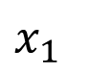
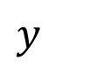
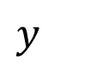
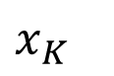
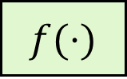
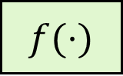

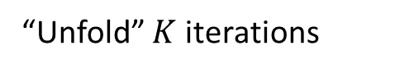
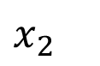
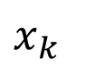
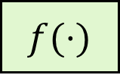
Deep unfolding/unrolling
Explicit embedding of structural signal priors in deep networks
$x_{k}$
$x_{1}$
$x_{2}$
$x_{K}$
$y$
$$f(⋅)$$
“Unfold” $K$ iterations
$$f(⋅)$$
$$f(⋅)$$
$$f(⋅)$$
$y$
Iterative model-based algorithm
with input y and output x that leverages some signal structure
unfolded model-based algorithm
with input y and output x that leverages some signal structure

Slide 17
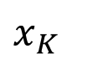
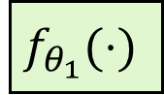
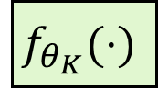
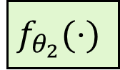
Deep unfolding
Explicit embedding of structural signal priors in deep networks
$x_{k}$
$x_{1}$
$x_{2}$
$x_{K}$
$y$
$$f(⋅)$$
“Unfold” $K$ iterations
$$f_{θ_{1}}(⋅)$$
$$f_{θ_{2}}(⋅)$$
$$f_{θ_{K}}(⋅)$$
$y$
Iterative model-based algorithm
with input y and output x that leverages some signal structure
unfolded model-based algorithm
with learned parameters that leverages some signal structure

Slide 18

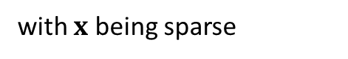
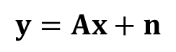
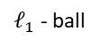
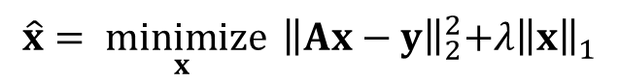
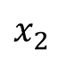
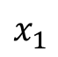
Deep unfolding
Example: sparse coding
Many applications: denoising, compressed sensing, image reconstruction, super-resolution, …
$x_{k}$
Sparse coding problem
$$y=Ax+n$$
with $x$ being sparse
Some intuition:
$$x_{2}$$
$y$
$$f(⋅)$$
Find $x$:
$$\underset{ x}{\hat{x}= minimize}{{{ \left\|Ax−y\right\|}_{2}^{2}+λ\left\|x\right\|}_{1}}$$
Iterative model-based algorithm
with input y and output x that leverages signal sparsity
0
$$x_{1}$$
$ℓ_{1}$ - ball

Slide 19
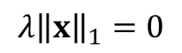
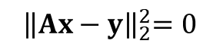
Deep unfolding
Example: sparse coding
Many applications: denoising, compressed sensing, image reconstruction, super-resolution, …
$x_{k}$
Sparse coding problem
$$y=Ax+n$$
with $x$ being sparse
Some intuition:
$$x_{2}$$
$y$
$$f(⋅)$$
Find $x$:
$$\underset{ x}{\hat{x}= minimize}{{{ \left\|Ax−y\right\|}_{2}^{2}+λ\left\|x\right\|}_{1}}$$
Proximal gradient methods
Iterative shrinkage and thresholding
Iterative model-based algorithm
with input y and output x that leverages signal sparsity
0
$$x_{1}$$
Take a gradient step towards
Move it in the proximity of
$${ \left\|Ax−y\right\|}_{2}^{2}=0$$
$ℓ_{1}$ - ball
$${λ\left\|x\right\|}_{1}=0$$

Slide 20
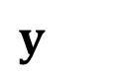
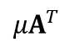
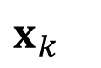

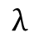
Deep unfolding
Example: sparse coding
Many applications: denoising, compressed sensing, image reconstruction, super-resolution, …
$x_{k}$
Sparse coding problem
$$y=Ax+n$$
with $x$ being sparse
$y$
$$f(⋅)$$
Find $x$:
$$\underset{ x}{\hat{x}= minimize}{{{ \left\|Ax−y\right\|}_{2}^{2}+λ\left\|x\right\|}_{1}}$$
Iterative shrinkage and thresholding
$$λ$$
Proximity operator
Iterative model-based algorithm
with input y and output x that leverages signal sparsity
Soft thresholding
$y$
$${μA}^{T}$$
+
$x_{k}$
$$I−μA^{T}A$$

Slide 21


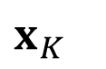
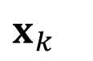

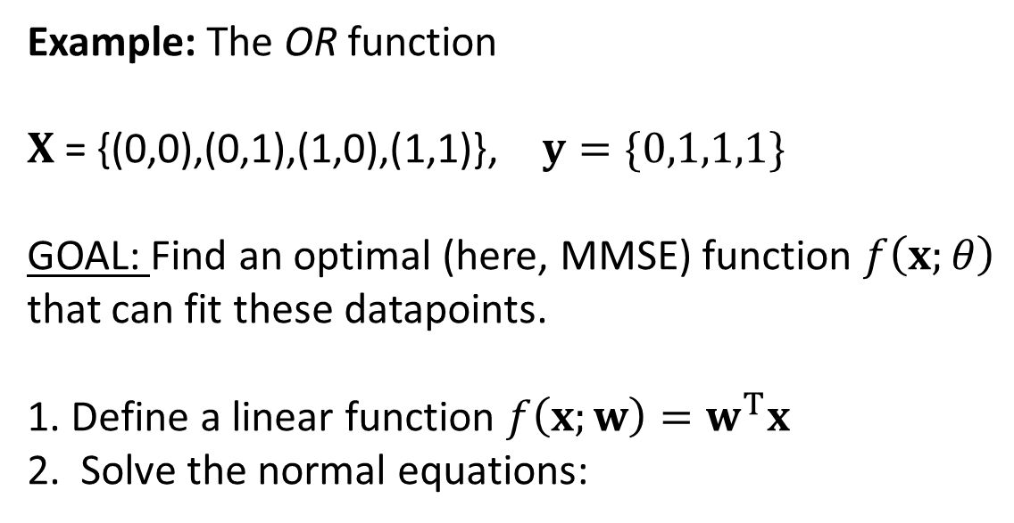
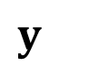
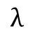
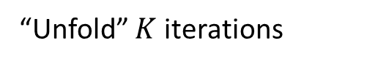
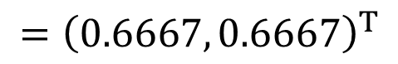
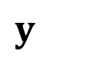


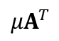


Deep unfolding
Example: sparse coding
Many applications: denoising, compressed sensing, image reconstruction, super-resolution, …
Model-based layer
$y$
$$W_{1}$$
$$W_{3}$$
$$W_{2K−1}$$
“Unfold” $K$ iterations
$$W_{2}$$
$$W_{4}$$
+
+
$x_{K}$
$$λ$$
$$λ_{0}$$
$$λ_{1}$$
$$λ_{K}$$
$y$
$${μA}^{T}$$
+
$x_{k}$
Deep learning with a model-based signal prior
Robust, intuitive, interpretable
Fast learning
Data efficient
Low complexity and memory footprint
$$I−μA^{T}A$$

Slide 22
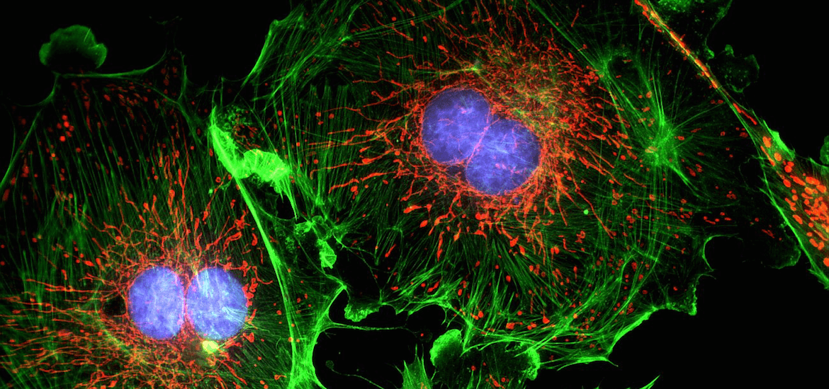

DL for super resolution microscopy
Ultrasound localization microscopy
Optical fluorescence microscopy

Slide 23


DL for super resolution microscopy
Ultrasound localization microscopy
Acquisition time
Errico et al., 2015
?
Indicator concentration
Localization precision
Low concentration
High concentration
High precision
Low precision
Long acquisition time
Short acquisition time

Slide 24









Deep unfolded sparse coding Learned convolutional ISTA
Iterative shrinkage and thresholding (ISTA)
$$\underset{ x}{\hat{x}= minimize}{{{ \left\|Ax−y\right\|}_{2}^{2}+λ\left\|x\right\|}_{1}}$$
$$λ$$
$$x_{k}$$
$A:$ Known measurement (PSF) matrix
$${μA}^{T}$$
+
$y:$ Measurement
Low-res input
High-res
Sparse output
$x:$ Sparse target location vector
$$I−μA^{T}A$$
$$x_{k−1}$$
Deep unfolded ISTA
Model-aware layer
5x5 filter
conv
conv
conv
Thousands of iterations
conv
conv
+
+
Deep unfolding
$$λ_{0}$$
$$λ_{1}$$
$$λ_{K}$$
van Sloun et al. IUS, 2019
Only 10 unfolded iterations
van Sloun et al. Proc. IEEE, 2019

Slide 25



Deep unfolded sparse coding for ultrasound microscopy Learned convolutional ISTA
$$200 μm$$

Slide 26















Deep unfolded low-rank + sparse coding for clutter removal Learned convolutional ISTA for RPCA
Recall sparse coding:
$$\underset{ S}{\hat{S}= min}{{{ \left\|AS−D\right\|}_{2}^{2}+λ\left\|S\right\|}_{1}}$$
Sparse targets
Stack of images
Block diagram:
Low-rank clutter
+
Low-rank
clutter
Input frames
Update steps:
+
Sparse
targets

Slide 27










Deep unfolded low-rank + sparse coding for clutter removal Learned convolutional ISTA for RPCA
ISTA for RPCA
Deep convolutional Robust PCA
+
Low-rank clutter
+
Low-rank clutter
Learned Convolution (5x5)
Singular value thresholding
Input frames
Input frames
Mixed l1 l2 thresholding
Deep unfolding
Sparse targets
+
Sparse targets
+
Cohen et al. ICASSP, 2018
Cohen et al. IEEE TMI, 2019
van Sloun et al. Proc. IEEE, 2019

Slide 28
Deep unfolded low-rank + sparse coding for clutter removal Learned convolutional ISTA for RPCA
Deep convolutional Robust PCA
Model-based feedforward neural network
+
Low-rank clutter
Learned Convolution (5x5)
Singular value thresholding
Input frames
Mixed l1 l2 thresholding
Sparse target
+

Slide 29




Neural proximal gradient descent
What if you know the model (e.g. $y=Ax$) but not the signal prior?
Again, many applications: denoising, compressed sensing, image reconstruction, super-resolution, …
Recall unfolded ISTA for sparse coding (known prior, sparsity):
$$λ$$
Model-based layer (learned gradient step)
$y$
$${μA}^{T}$$
+
$x_{k}$
$y$
$$W_{1}$$
$$W_{3}$$
$$W_{2K−1}$$
$$W_{2}$$
$$W_{4}$$
$x_{K}$
+
+
$$I−μA^{T}A$$
$$λ_{0}$$
$$λ_{1}$$
$$λ_{K}$$
“Unfold” $K$ iterations
Remember the iterative update rule:
Take a gradient step towards
Move it in the proximity of
$${ \left\|Ax−y\right\|}_{2}^{2}=0$$
$${λ\left\|x\right\|}_{1}=0$$
= proximal operator/mapping
= the prior/regularizer
(here: sparsity of x)

Slide 30










Neural proximal gradient descent
What if you know the model (e.g. $y=Ax$) but not the signal prior?
Again, many applications: denoising, compressed sensing, image reconstruction, super-resolution, …
Recall unfolded ISTA for sparse coding (known prior, sparsity):
$$λ$$
Model-based layer (learned gradient step)
$y$
$${μA}^{T}$$
+
$x_{k}$
$y$
$$W_{1}$$
$$W_{3}$$
$$W_{2K−1}$$
$$W_{2}$$
$$W_{4}$$
$x_{K}$
+
+
$$I−μA^{T}A$$
$$λ_{0}$$
$$λ_{1}$$
$$λ_{K}$$
“Unfold” $K$ iterations
Neural proximal gradient descent (known model, learned prior)
Model-based layer (learned proximal mapping)
$y$
$${μA}^{T}$$
+
$${ 𝒫}_{θ}^{(k)}(⋅)$$
$x_{k}$
$y$
$$A^{T}$$
$${μA}^{T}$$
$${μA}^{T}$$
$$I−μA^{T}A$$
$$I−μA^{T}A$$
$${ 𝒫}_{θ}^{(1)}$$
+
$${ 𝒫}_{θ}^{(2)}$$
+
$${ 𝒫}_{θ}^{(K)}$$
$x_{K}$
$$I−μA^{T}A$$
“Unfold” $K$ iterations

Slide 31





















Neural proximal gradient descent
Neural proximal gradient descent (known model, learned prior)
Model-based layer (learned proximal mapping)
$y$
$${μA}^{T}$$
+
$${ 𝒫}_{θ}^{(k)}(⋅)$$
$x_{k}$
$y$
$$A^{T}$$
$${μA}^{T}$$
$${μA}^{T}$$
$$I−μA^{T}A$$
$$I−μA^{T}A$$
$${ 𝒫}_{θ}^{(1)}$$
+
$${ 𝒫}_{θ}^{(2)}$$
+
$${ 𝒫}_{θ}^{(K)}$$
$x_{K}$
$$I−μA^{T}A$$
“Unfold” $K$ iterations
Example: fast MRI reconstruction from known undersampled/compressed acquisitions
K-space
Undersampled K-space
Neural proximal gradient network
Reconstruction
$$A^{T}$$
$${μA}^{T}$$
$${μA}^{T}$$
$$I−μA^{T}A$$
$$I−μA^{T}A$$
$${ 𝒫}_{θ}^{(1)}$$
+
$${ 𝒫}_{θ}^{(2)}$$
+
$${ 𝒫}_{θ}^{(K)}$$
$$Ψ$$
$$A=ΨF$$
(Sampling matrix)
(partial Fourier matrix)
Learn the MR image prior
[Huijben et al., IEEE ICASSP, 2020]

Slide 32
Architectural priors
$$λ$$
$$x_{k}$$
$${μA}^{T}$$
+
$$I−μA^{T}A$$
$$x_{k−1}$$
(Group) convolutional neural networks
Recurrent neural networks
Deep unfolding

